Slide 1

Challenges and Disparities Faced by LGBTQ+ Students in the Transition to College Survey Evidence from the California High School Class of 2023
University of California, Davis
Note: This research was supported by the College Futures Foundation and conducted in partnership with the California Student Aid Commission. The authors are also grateful for ongoing support from the Stuart Foundation to the California Education Lab. The California Education Lab at the University of California, Davis and Policy Analysis for California Education are also thankful for research dissemination support from the Bill & Melinda Gates Foundation. The findings and conclusions here are those of the authors alone and do not necessarily reflect the positions or policies of the funders or of the California Student Aid Commission.

Slide 2
Overview
This project utilizes a large student survey to explore how sexual and gender minority high school students define and express their identities, and the challenges they face in the transition to college.
Motivation
Methodology
Data
Results
Discussion

Slide 3
Motivation
The high school to college transition is crucial for young adults (Luh et al., 2023)
Schools shape students’ perceptions of college and future educational attainment (Lynn et al., 2010; Uwah et al., 2008)
Existing research documents differences in outcomes among historically underserved groups
Limited evidence regarding LGBTQ+ students
This study provides direct evidence on LGBTQ+ students’ experiences before college, focusing on supports, challenges, and disparities

Slide 4
Context
Pandemic
Remote start to high school
Significant portion of high school was conducted online
Policy changes in financial aid application submission
AB 469 (2021) mandates graduating high school seniors to complete a FAFSA or CADAA (with opt-out waivers)
Class of 2023 is first cohort
Heightened visibility of and backlash against LGBTQ+ people
Study conducted in California
Diverse demographic and political leanings

Slide 5
Research Questions
How do high school students today define their own gender identity and sexual orientation?
Are there different patterns in experiences and aspirations among sexual and gender minority students?
What are the challenges faced by sexual and gender minority students in the transition to college?

Slide 6
Contributions
Use validated survey instruments to collect nuanced data on gender identity and sexual orientation from a large sample of high school seniors
Recent surveys tend to draw on a narrow sample of students, students predominantly enrolled in earlier grades, or data collected pre-pandemic (Austin et al., 2023; Horowitz & Graf, 2019; Kosciw et al., 2022; Reber & Smith, 2023; YouScience, 2023)
Add to the growing literature on the academic and social experiences of LGBTQ+ students in high school and college (e.g., Austin et al., 2023; Feldman et al., 2023; Kosciw et al., 2022; Reber & Smith, 2023)
Contribute to the broader literature on the transition to college by adding new evidence on the experiences of underserved students

Slide 7
Methodology
Launched an internet-based survey in May 2023 in partnership with the California Student Aid Commission (CSAC)
Distributed by email to all high school seniors in California that submitted a Free Application for Federal Student Aid (FAFSA) or California Dream Act Application (CADAA) for the 2023-24 academic year
Response rate of 3.5%, yet the sample represents a diverse group of students from many different backgrounds and geographic regions throughout the state
Convenience sample but large
Likert-scale questions
Students’ high school experiences, college preparation and plans, concerns about college
Demographic questions
Open-ended questions
Perceived challenges and excitement about college

Slide 8
Data
The raw sample includes a total of 10,221 responses
Our sample includes around 9,230 college-bound HS seniors
7,522 who reported gender identity
7,481 who reported sexual orientation
Our sample includes 1,828 LGBTQ+ students (excluding Prefer Not to Say)
417 who we classify as being non-cisgender
1,782 who we classify as being non-heterosexual

Slide 9
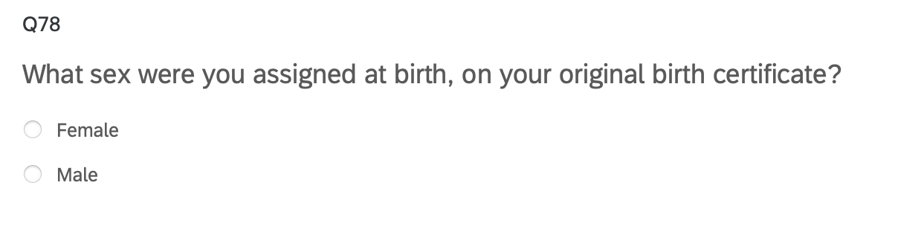
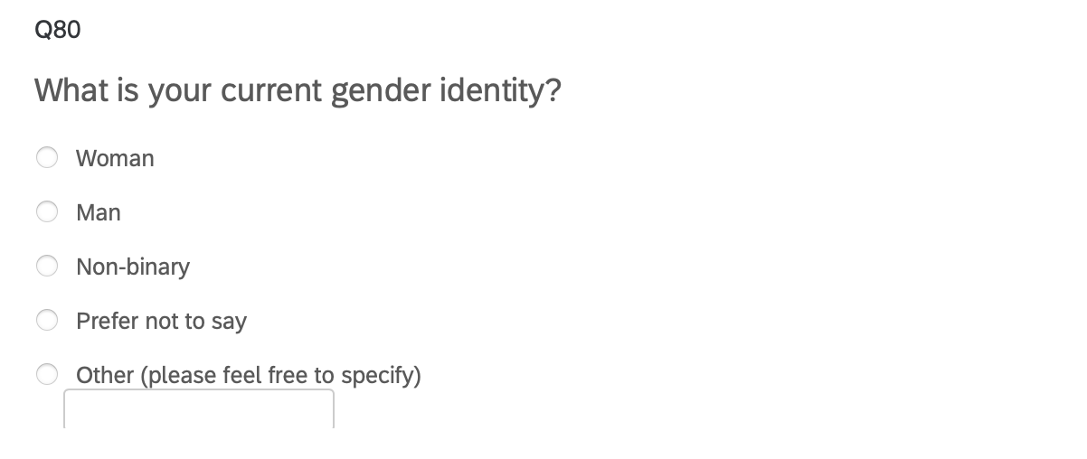
Survey Instrument: Gender Identity
“Two-Step” Approach recommended by the Williams Institute

Slide 10
How we classify

Slide 11
How we define terms

Slide 12
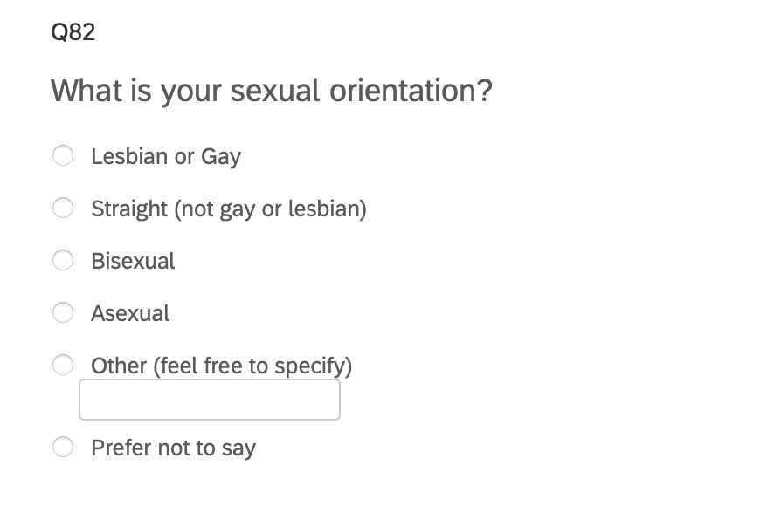
Survey Instrument: Sexual Orientation
Adapted from recommendations by the Williams Institute to allow for a broader range of expressions

Slide 13
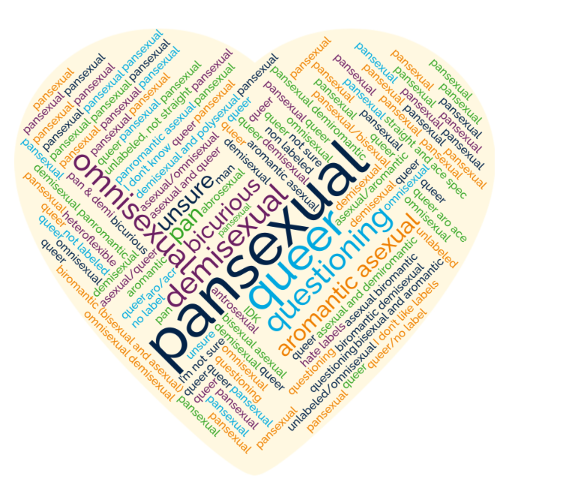
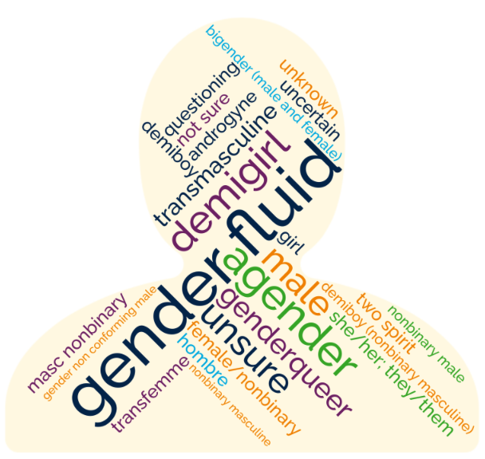
Students’ Self Descriptions of Gender and Sexual Orientation
Notes:
Students who chose to self describe used a diversity of descriptors
25 unique words to describe gender identities
47 unique words to describe sexual orientations

Slide 14
High School Experience

Slide 15
Result 1: Transgender students and gender diverse students are more likely to report having a Poor or Fair social experience in high school.

Slide 16
Result 2: Gender and sexual minority students are less likely to report a sense of belonging in their high school community.

Slide 17
Result 3: Transgender students are the most likely to have been bullied in the last 12 months. Cisgender and straight students are the least likely to be bullied.

Slide 18
Result 4: Of the students that reported being bullied, transgender students and almost all gay/lesbian students are exclusively bullied because of gender or sexual orientation.

Slide 19
College Plans

Slide 20
Highest Degree Aspirations:

Slide 21
College Major: There is a significant gender gap in plans to pursue engineering. More trans and gender diverse students plan to major in humanities and arts than any other group.
Notes:
mention the cell size issue for trans women and trans men
change the language about being exclusively bullied for gender/so
stress long standing partnership with CSAC and they send the survey out

Slide 22
Worries About College

Slide 23
Result 7: Transgender and gender diverse students report highest levels of worry about discrimination based on gender.

Slide 24
Result 8: Gay and lesbian students report higher levels of worry about discrimination on sexual orientation.

Slide 25
Result 9: Cisgender and heterosexual students are the least worried about finding community.

Slide 26
Result 10: Sexual and gender minority students are more worried about finding adequate emotional and mental health support.

Slide 27
Student Voices
CW: Suicide

Slide 28
Student Voices: What do you think is the biggest challenge you’ll face in college?
“TRANSPHOBIA”
“POLITICAL AND SOCIAL CONFLICTS. I COULD DIE FROM HATE CRIMES, BUT IT'S MORE LIKELY THAT I END UP KILLING MYSELF. I STRUGGLE A LOT WITH BEING TRANS AND IF NOT ABLE TO TRANSITION IN COLLEGE, I'M GOING TO GIVE UP ON EVERYTHING. THE POLITICAL CLIMATE IN TAIWAN COULD REACH A TIPPING POINT WHILE I AM IN COLLEGE. IF THAT HAPPENS, I AM LIKELY GOING TO DROP EVERYTHING TO HELP MY FAMILY.”
“LACK OF COMMUNITY DUE TO DISCRIMINATION”
“I THINK THE BIGGEST CHALLENGE WILL BE STANDING UP FOR MYSELF.”
“COMING OUT TO PEOPLE AROUND ME.”

Slide 29
Student Voices: What are you most excited about college?
“BEING ABLE TO BUILD A COMMUNITY FOR MYSELF WHERE I TRULY FEEL THAT I BELONG.”
“I'M EXCITED TO BE MYSELF. I LIVE IN A HOUSE OF FIVE. I'M THE YOUNGEST OF MY THREE SIBLINGS, MEANING I'VE HAD TO SHARE A ROOM WITH MY 23 YEAR OLD SISTER SINCE I WAS BORN. I'VE NEVER HAD PRIVACY AND I NEVER FELT LIKE I COULD BE MYSELF. TO USE BROAD TERMS, I COULD NEVER PROPERLY EXPRESS MYSELF AS A GAY, TRANS TEEN. I CAN'T WAIT TO MAKE NEW FRIENDS AND ENJOY MY NEW FOUND INDEPENDENCE. “I’M [EXCITED] ABOUT MOVING FROM HOME AND WORKING TO ESTABLISH MY INDEPENDENCE.”
“GETTING OUT OF MY SMALL AREA BUBBLE AND LIVING ON MY OWN AS MY OWN PERSON.”

Slide 30
Questions and Comments
ucsun@ucdavis.edu
christinasun.net
Notes:
Binary trans: add caveat

Slide 31
Thank you!
California Education Lab
Elizabeth Friedmann
Sherrie Reed
Paco Martorell
Scott Carrell
California Student Aid Commission
Marlene Garcia
Jessica Moldoff
Ryan Fuller
This research was supported by the College Futures Foundation and conducted in partnership with the California Student Aid Commission. The authors are also grateful for ongoing support from the Stuart Foundation to the California Education Lab. The California Education Lab at the University of California, Davis and Policy Analysis for California Education are also thankful for research dissemination support from the Bill & Melinda Gates Foundation. The findings and conclusions here are those of the authors alone and do not necessarily reflect the positions or policies of the funders or of the California Student Aid Commission.

